Slide 1
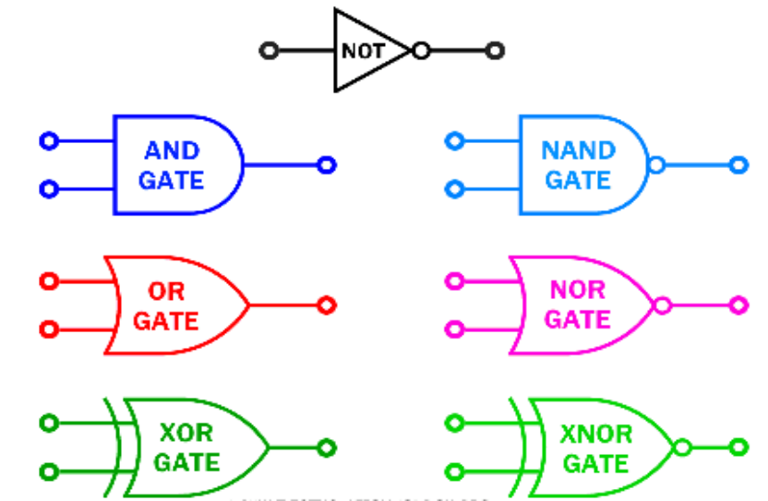
Unit 3.2 - Logic Gates & Logic Circuits
Prepared by: Koh Kian Hua

Slide 2
Objectives (Part 1)
After completing this unit, students should be able to:
Understand logic circuit design for real world applications.
Using NAND gate as basic building blocks to construct any logic gates.
Simplify logic gates by cutting down the components to reduce production cost.
Understand the operations of multi-input logic gates.

Slide 3
Logic Gates & Logic Circuits
Logic Circuits for Practical Applications
Companies need to consider the cost, ease of fabrication and time constraint when designing logic circuits.
Factors that impact the review of logic circuit design includes:
  Use off the shelf logic circuits and basic building blocks to construct logic circuits.
  Simplifying the logic circuits as far as possible.

Slide 4
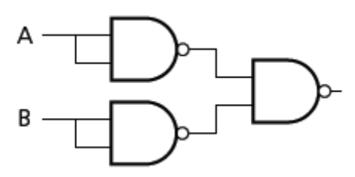
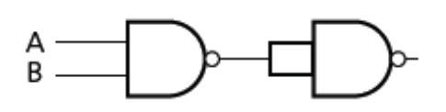
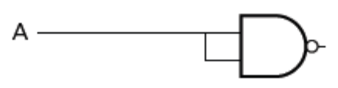
Logic Gates & Logic Circuits
Using "NAND" gate as basic building block
NAND gate is the basic building block.
It is possible to build any logic circuits using a number of NAND gates.
NOT gate made from NAND gate
AND gate made from NAND gate
OR gate made from NAND gate

Slide 5
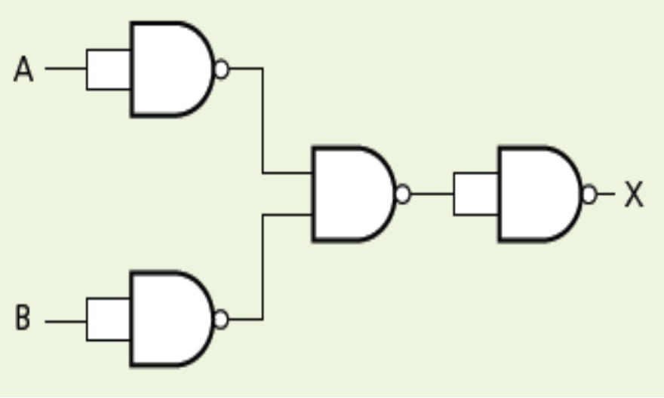
Logic Gates & Logic Circuits
Class Activity
Draw a truth table and identify which single logic gate has the same function as the following logic circuit made up of NAND gates only.

Slide 6
Logic Gates & Logic Circuits
Simplification of Logic Gates
Logic gates can be simplified by reducing the number of components. This has a few advantages:
  Cost of production is less
  Improve reliability as it's easier to trace faults.
Both the original circuit and the reduced circuit will have the same truth table.
To reduce a circuit, we can continuously apply the laws and rules of Boolean Algebra until you get the smallest possible expression

Slide 7
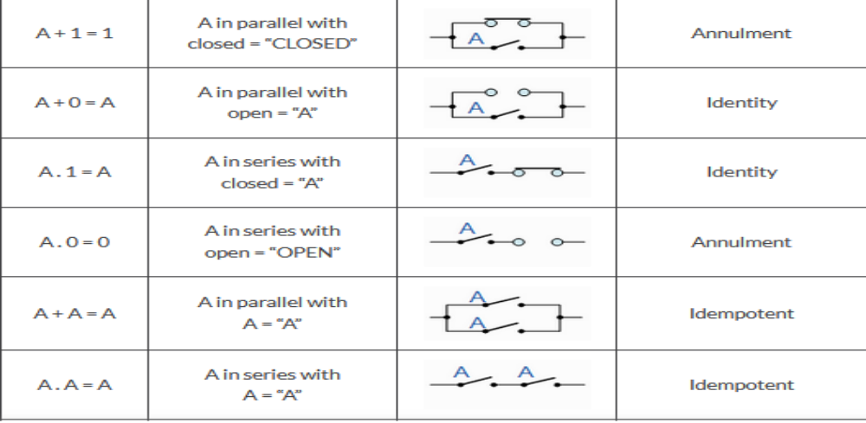
Logic Gates & Logic Circuits
Laws of Boolean Algebra (1)

Slide 8
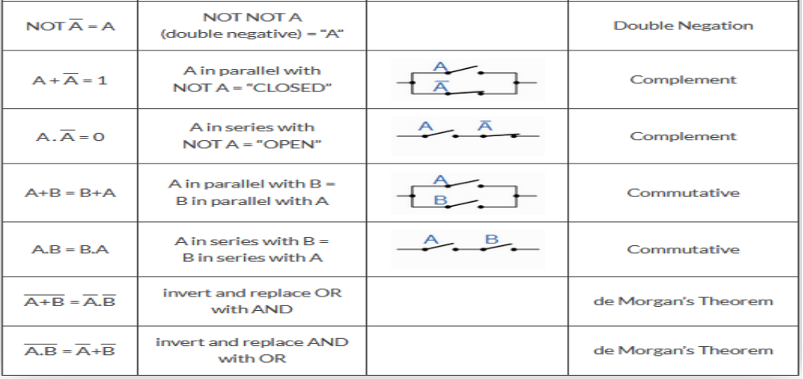
Logic Gates & Logic Circuits
Laws of Boolean Algebra (2)

Slide 9
Logic Gates & Logic Circuits
Laws of Boolean Algebra (3)
Distributive Law – This law permits the multiplying or factoring out of an expression.
  A(B + C) = A.B + A.C (OR Distributive Law)
  A + (B.C) = (A + B).(A + C) (AND Distributive Law)
Absorptive Law – This law enables a reduction in a complicated expression to a simpler one by absorbing like terms.
  A + (A.B) = (A.1) + (A.B) = A(1 + B) = A (OR Absorption Law)
  A(A + B) = (A + 0).(A + B) = A + (0.B) = A (AND Absorption Law)
Associative Law – This law allows the removal of brackets from an expression and regrouping of the variables.
  A + (B + C) = (A + B) + C = A + B + C (OR Associate Law)
  A(B.C) = (A.B)C = A . B . C (AND Associate Law)

Slide 10
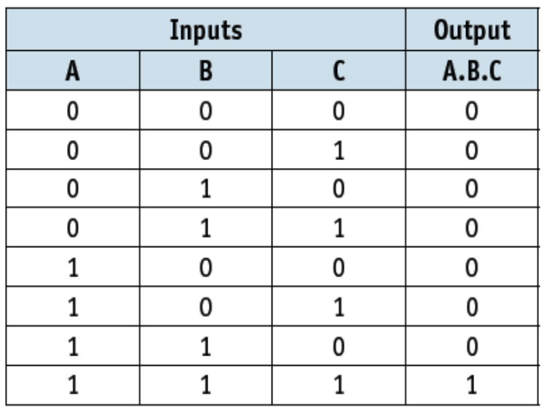
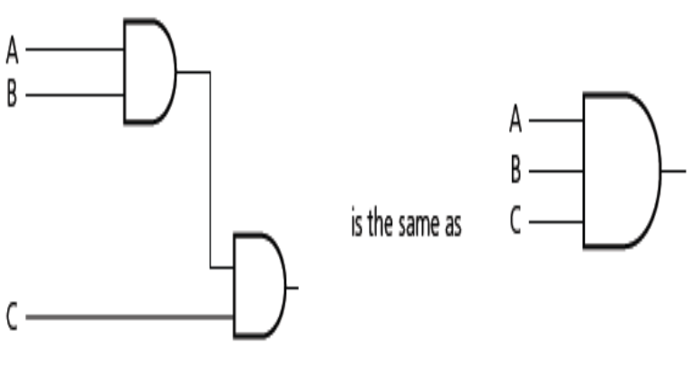
Logic Gates & Logic Circuits
Multi-Input AND Gates
Logic gates can have more than two inputs. When designing logic circuits, multi-input logic gates can be used to simplify the overall result.

Slide 11
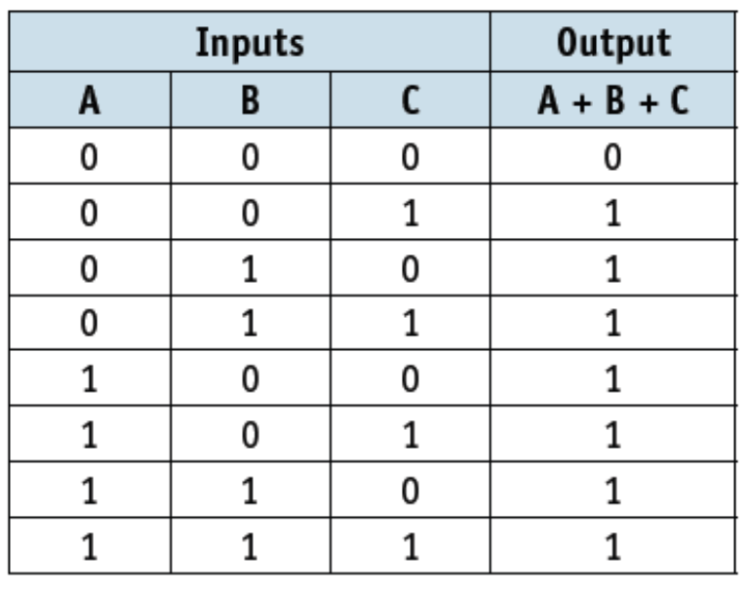
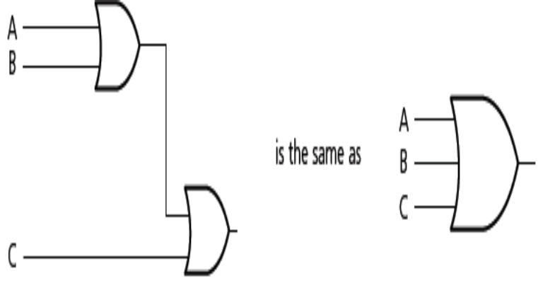
Logic Gates & Logic Circuits
Multi-input OR Gates
Both sets of OR gates have the output A + B + C and they share identical truth tables.

Slide 12
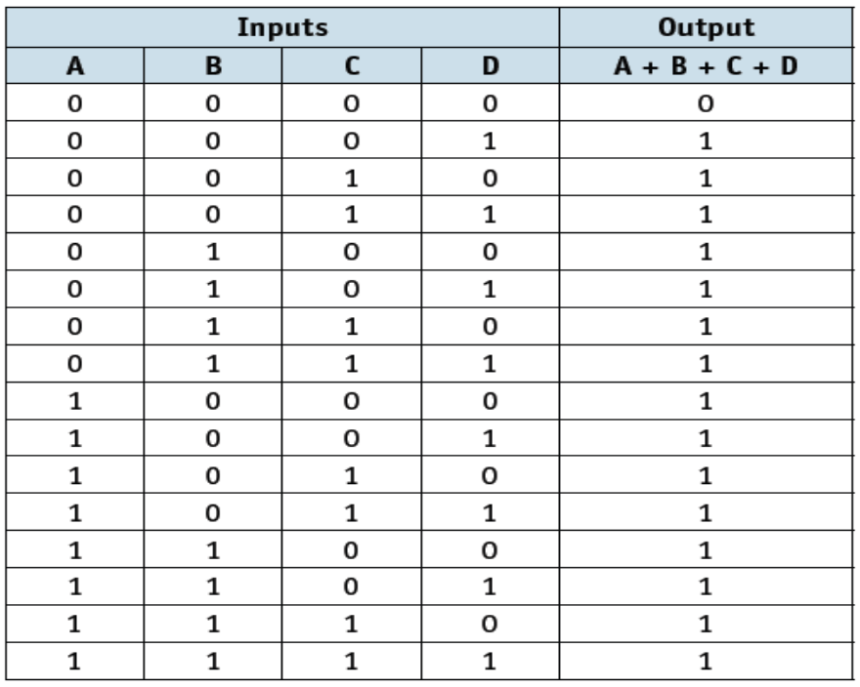
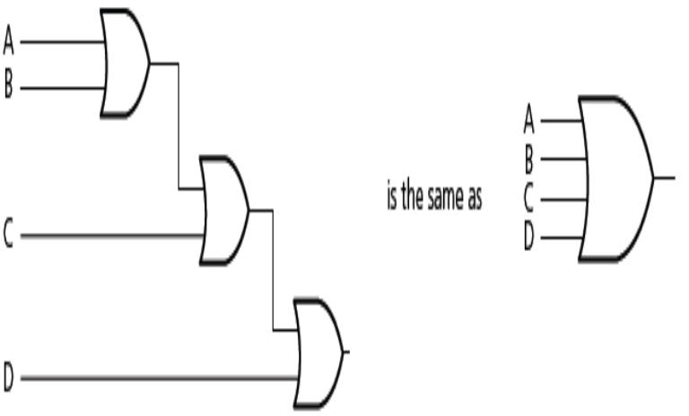
Logic Gates & Logic Circuits
Multi-input OR Gates (2)
Both sets of OR gates have the output A + B + C + D and they share identical truth tables.

Slide 13
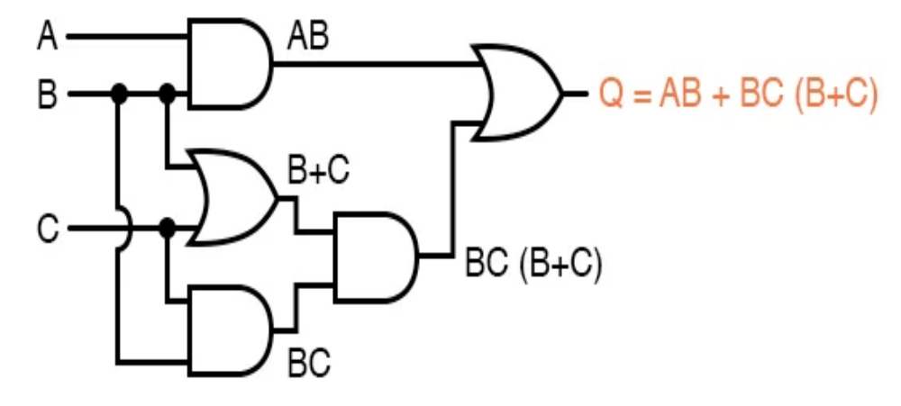
Logic Gates & Logic Circuits
Homework
Apply the laws of Boolean Algebra to reduce the cicrcuit to it's simplest form

